Slide 1
Data management patterns

Slide 2
Cache-Aside

Slide 3
What is Cache-Aside pattern
Load data on demand into a cache from a data store. This can improve performance and also helps to maintain consistency between data held in the cache and data in the underlying data store.

Slide 4
Solution
Many commercial caching systems provide read-through and write-through/write-behind operations. In these systems, an application retrieves data by referencing the cache.
If the data isn't in the cache, it's retrieved from the data store and added to the cache. Any modifications to data held in the cache are automatically written back to the data store as well.
For caches that don't provide this functionality, it's the responsibility of the applications that use the cache to maintain the data.

Slide 5
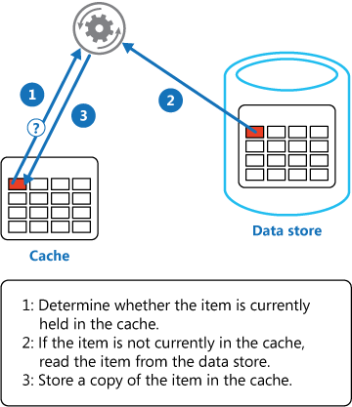
An application can emulate the functionality of read-through caching by implementing the cache-aside strategy. This strategy loads data into the cache on demand.
The figure illustrates using the Cache-Aside pattern to store data in the cache

Slide 6
When to use this pattern
Use this pattern when:
A cache doesn't provide native read-through and write-through operations.
Resource demand is unpredictable. This pattern enables applications to load data on demand. It makes no assumptions about which data an application will require in advance.

Slide 7
The GetMyEntityAsync method in the following code example shows an implementation of the Cache-Aside pattern. This method retrieves an object from the cache using the read-through approach.
// Set five minute expiration as a default
private const double DefaultExpirationTimeInMinutes = 5.0;
public async Task<MyEntity> GetMyEntityAsync(int id)
{
// Define a unique key for this method and its parameters.
var key = $"MyEntity:{id}";
var cache = Connection.GetDatabase();
// Try to get the entity from the cache.
var json = await cache.StringGetAsync(key).ConfigureAwait(false);
var value = string.IsNullOrWhiteSpace(json)
? default(MyEntity)
: JsonConvert.DeserializeObject<MyEntity>(json);

Slide 8
Event Sourcing

Slide 9
What is Event Sourcing pattern
Instead of storing just the current state of the data in a domain, use an append-only store to record the full series of actions taken on that data. The store acts as the system of record and can be used to materialize the domain objects.
This can simplify tasks in complex domains, by avoiding the need to synchronize the data model and the business domain, while improving performance, scalability, and responsiveness. It can also provide consistency for transactional data, and maintain full audit trails and history that can enable compensating actions.

Slide 10
Solution
The Event Sourcing pattern defines an approach to handling operations on data that's driven by a sequence of events, each of which is recorded in an append-only store.
Application code sends a series of events that imperatively describe each action that has occurred on the data to the event store, where they're persisted. Each event represents a set of changes to the data (such as AddedItemToOrder).

Slide 11
When to use this pattern
Use this pattern in the following scenarios:
When you want to capture intent, purpose, or reason in the data. For example, changes to a customer entity can be captured as a series of specific event types, such as Moved home, Closed account, or Deceased.
When it's vital to minimize or completely avoid the occurrence of conflicting updates to data.
When you want to record events that occur, and be able to replay them to restore the state of a system, roll back changes, or keep a history and audit log. For example, when a task involves multiple steps you might need to execute actions to revert updates and then replay some steps to bring the data back into a consistent state.

Slide 12
Static Content

Slide 13
What is Static Content Hosting pattern
Deploy static content to a cloud-based storage service that can deliver them directly to the client. This can reduce the need for potentially expensive compute instances.

Slide 14
Solution
In most cloud hosting environments, you can put some of an application's resources and static pages in a storage service. The storage service can serve requests for these resources, reducing load on the compute resources that handle other web requests.
The cost for cloud-hosted storage is typically much less than for compute instances

Slide 15
When to use this pattern
This pattern is useful for:
Minimizing the hosting cost for websites and applications that contain some static resources.
Minimizing the hosting cost for websites that consist of only static content and resources. Depending on the capabilities of the hosting provider's storage system, it might be possible to entirely host a fully static website in a storage account.
Exposing static resources and content for applications running in other hosting environments or on-premises servers.

Slide 16
This pattern might not be useful in the following situations:
The application needs to perform some processing on the static content before delivering it to the client. For example, it might be necessary to add a timestamp to a document.
The volume of static content is very small. The overhead of retrieving this content from separate storage can outweigh the cost benefit of separating it out from the compute resource.

Slide 17
example
<Setting name="StaticContent.StorageConnectionString" value="UseDevelopmentStorage=true" /><Setting name="StaticContent.Container" value="static-content" />

Slide 18
The Settings class in the file Settings.cs of the StaticContentHosting.Web project contains methods to extract these values and build a string value containing the cloud storage account container URL.
public class Settings
{
public static string StaticContentStorageConnectionString {
get
{
return RoleEnvironment.GetConfigurationSettingValue(
"StaticContent.StorageConnectionString");
}
}
public static string StaticContentContainer
{
get
{
return RoleEnvironment.GetConfigurationSettingValue("StaticContent.Container");
}
}

Slide 19
public static string StaticContentBaseUrl
{
get
{
var blobServiceClient = new BlobServiceClient(StaticContentStorageConnectionString);
return string.Format("{0}/{1}", blobServiceClient.Uri.ToString().TrimEnd('/'), StaticContentContainer.TrimStart('/'));
}
}
}

Slide 20
Sharding

Slide 21
What is Sharding pattern
Divide a data store into a set of horizontal partitions or shards. This can improve scalability when storing and accessing large volumes of data.

Slide 22
Context and problem
A data store hosted by a single server might be subject to the following limitations:
Storage space
Computing resources.
Network bandwidth
Geography

Slide 23
Solution
Divide the data store into horizontal partitions or shards. Each shard has the same schema, but holds its own distinct subset of the data. A shard is a data store in its own right (it can contain the data for many entities of different types), running on a server acting as a storage node.

Slide 24
Pattern benefits
You can scale the system out by adding further shards running on additional storage nodes.
A system can use off-the-shelf hardware rather than specialized and expensive computers for each storage node.
You can reduce contention and improve performance by balancing the workload across shards.
In the cloud, shards can be located physically close to the users that'll access the data.

Slide 25
Scaling and data movement operations
Each of the sharding strategies implies different capabilities and levels of complexity for managing scale in, scale out, data movement, and maintaining state.
The Lookup strategy permits scaling and data movement operations to be carried out at the user level, either online or offline. The technique is to suspend some or all user activity (perhaps during off-peak periods), move the data to the new virtual partition or physical shard, change the mappings, invalidate or refresh any caches that hold this data, and then allow user activity to resume. Often this type of operation can be centrally managed. The Lookup strategy requires state to be highly cacheable and replica friendly

Slide 26
When to use this pattern
Use this pattern when a data store is likely to need to scale beyond the resources available to a single storage node, or to improve performance by reducing contention in a data store.

Slide 27
example
The following example in C# uses a set of SQL Server databases acting as shards. Each database holds a subset of the data used by an application. The application retrieves data that's distributed across the shards using its own sharding logic (this is an example of a fan-out query). The details of the data that's located in each shard is returned by a method called GetShards. This method returns an enumerable list of ShardInformation objects, where the ShardInformation type contains an identifier for each shard and the SQL Server connection string that an application should use to connect to the shard.

Slide 28
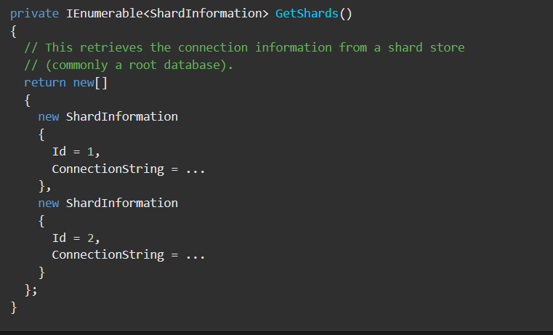

Slide 29
The code below shows how the application uses the list of ShardInformation objects to perform a query that fetches data from each shard in parallel. The details of the query aren't shown, but in this example the data that's retrieved contains a string that could hold information such as the name of a customer if the shards contain the details of customers. The results are aggregated into a ConcurrentBag collection for processing by the application.
/ Retrieve the shards as a ShardInformation[] instance.
var shards = GetShards();
var results = new ConcurrentBag<string>();
// Execute the query against each shard in the shard list.
// This list would typically be retrieved from configuration
// or from a root/primary shard store.
Parallel.ForEach(shards, shard =>
{
// NOTE: Transient fault handling isn't included,
// but should be incorporated when used in a real world application.
using (var con = new SqlConnection(shard.ConnectionString))
{
con.Open();
var cmd = new SqlCommand("SELECT ... FROM ...", con);

Slide 30
Trace.TraceInformation("Executing command against shard: {0}", shard.Id);
var reader = cmd.ExecuteReader();
// Read the results in to a thread-safe data structure.
while (reader.Read())
{
results.Add(reader.GetString(0));
}
}
});
Trace.TraceInformation("Fanout query complete - Record Count: {0}",
results.Count);

Slide 31


